Slide 1
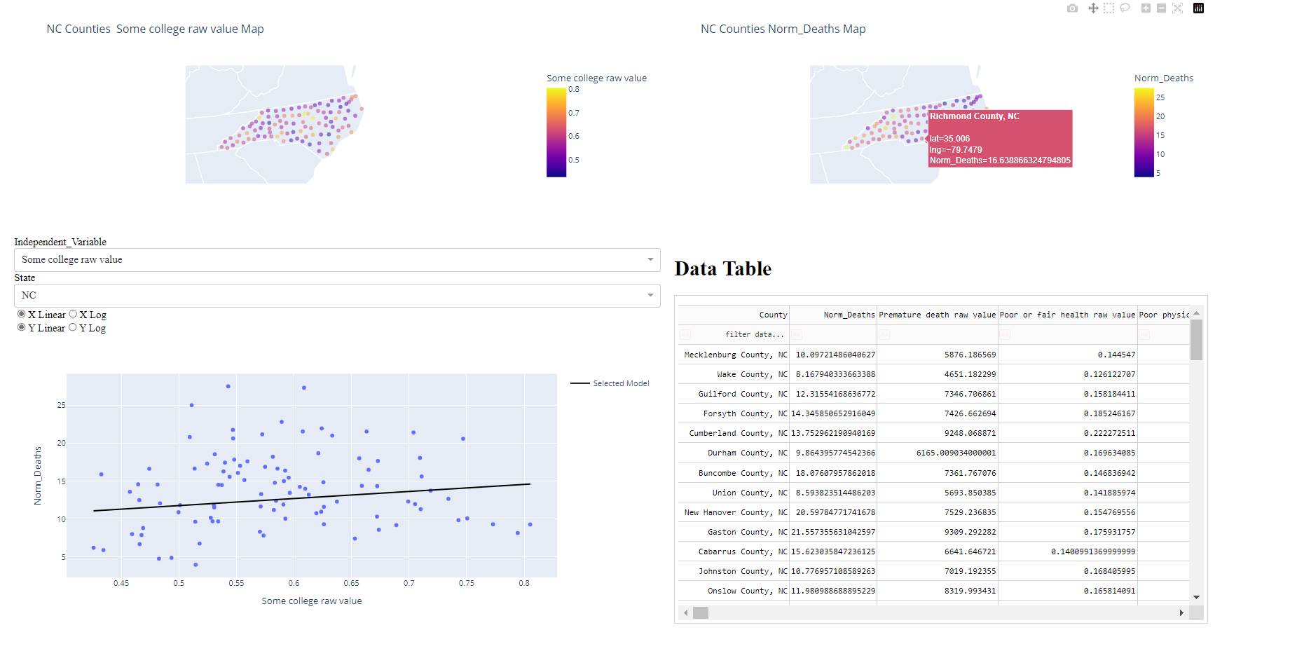

Slide 2
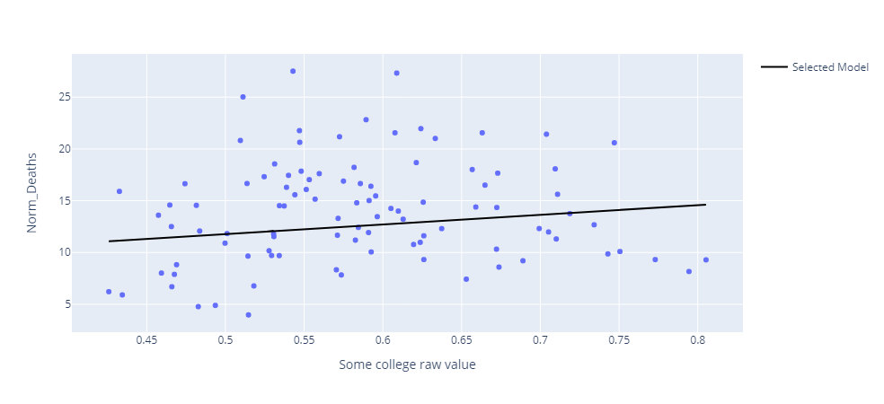
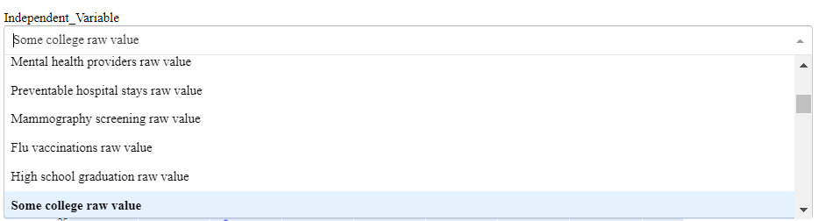
M1.1 Shows comparisons between a variable and Normalized Mortality rate in a scatter plot
Incorporate your best model prediction trend line - Linear / Non-Linear. (20 pts)
My best model is a linear model with zero intercept and predicts Norm_Deaths for each county based on five variables listed below. Coefficients for all variable are also shown after the variables:
Some college raw value (9.305841), Primary care physicians raw value (2516.532446), Life expectancy raw value (-0.074158), Premature death raw value (0.001117), and Unemployment raw value (35.279748)
This figure is saved from my Dash and shows the relation between Norm_Deaths and Some college raw value.
Fitted line is plotted by assuming average value for four other independent variables and the range of Some college raw value for NC counties.
Variable of interest can be selected from Independent Variable drop down.
All columns that has “raw value” in their name as well as Norm_Deaths column can be selected here.

Slide 3
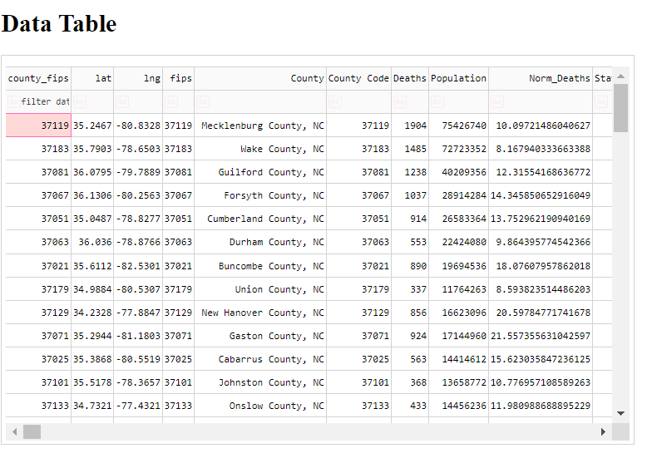
M1.2 Contains a data table (20 pts)
The screenshot of data table is taken from my dash. The data table contains all columns included in merge data frame.
The data table is linked to State selection drop down and shows record that belong to a certain state.
It also has a filter row in case you want to filter for certain values of individual field.

Slide 4
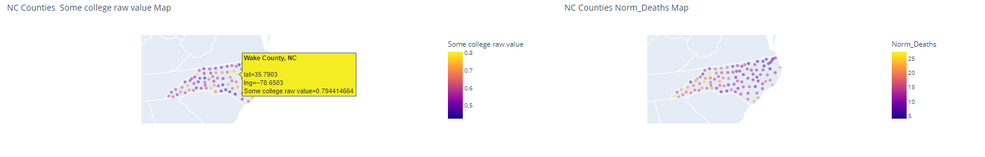
M1.3 Contains a map displaying values of either variables (20 pts)
On top of dashboard two maps are provided. The map on the left-hand side will vary depending on the selected variable. The map on the right-hand side will always show normalized death value.
If you hover over a data point on map, you’ll see the county name as well as the value of selected variable.
Each marker represent the latitude and longitude of centroid of each county. Map will be zoomed based on automatically calculated map center. Map center is be based on the average of latitude and longitude of counties with data in each state.
This took me more effort and it will be easier to show this map at state level. All you need to do is to aggregate at state level.

Slide 5
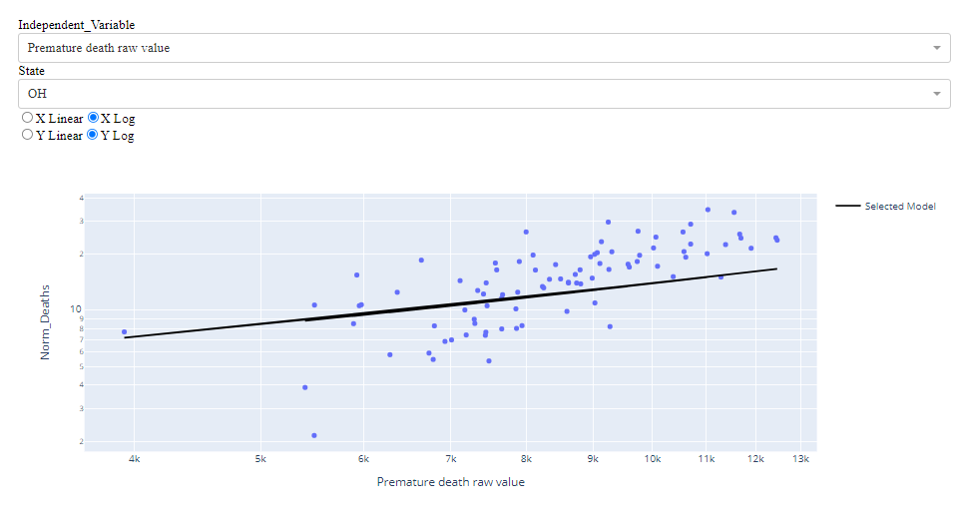
M1.4 Selectors (30 pts)
Allows for linear or log mode selection on both the variables for scatter plot.
I used the RadioItems to change the scale of y and x axes.
As clear activating X Log and Y Log buttons will make the two axes in log scale.

Slide 6
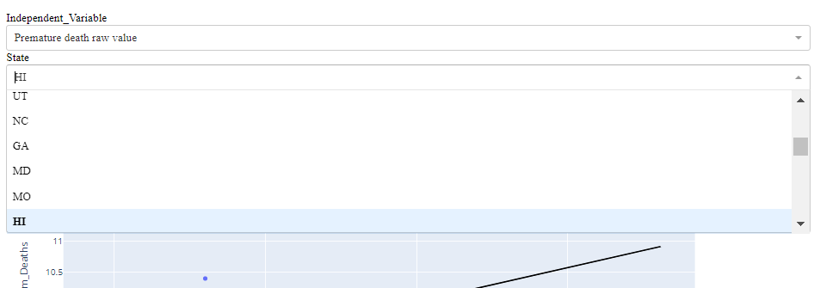
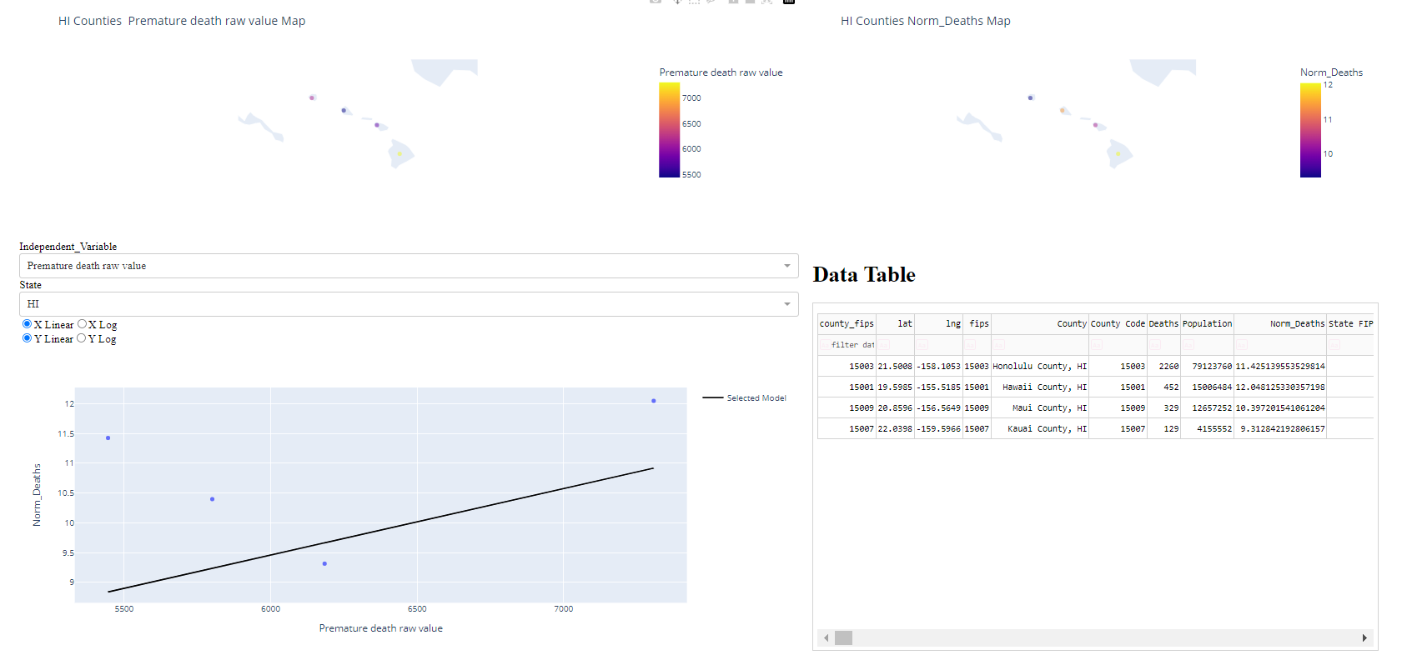
M1.4 Selectors (30 pts)
- Allows for selection of state.
I used dropdown option to select the state of interest. As you see the state can be selected from this list. Once selected, everything will be updated on dashboard (maps, data table, and scatter plot with fitted line based on selected model)

Slide 7
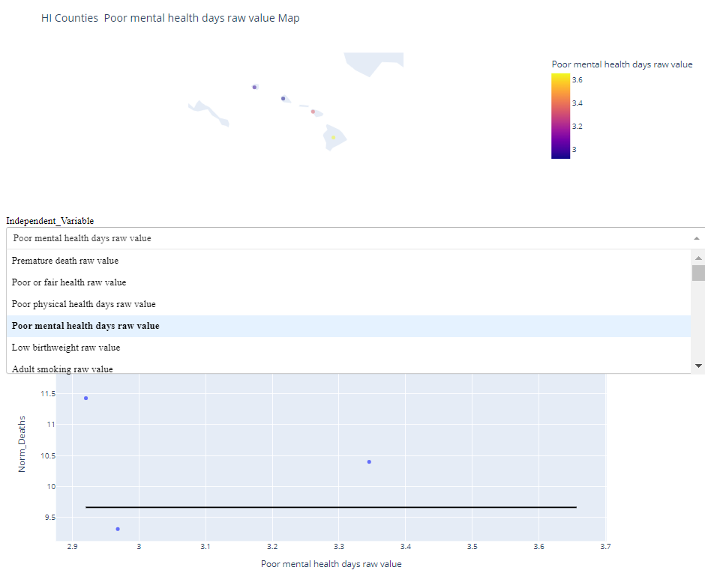
M1.4 Selectors (30 pts)
Allows for selection of which variable to display on the map.
Variable of interest can be selected from Independent Variable drop down.
All columns that has “raw value” in their name as well as Norm_Deaths column can be selected here.
By selecting the variable map will be updated for that variable.
The other map on the dashboard will always show Norm_Deaths values and does not depend on variable selection.

Slide 8
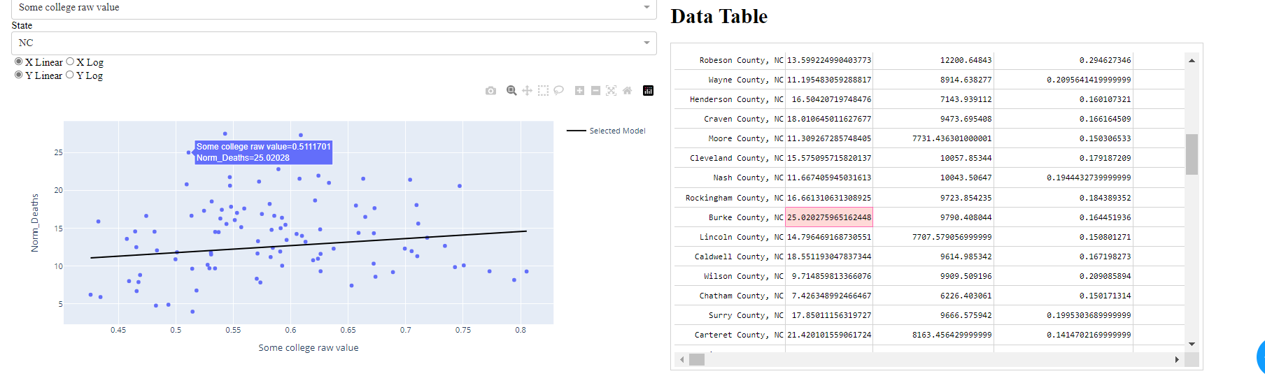
M1.4 Selection of on the graph or Data Table highlights the other ones. (10 pts)
Selection of point on the graph highlighted the other in table

